Slide 1
Chapter 23

Slide 2
Objectives

Slide 3
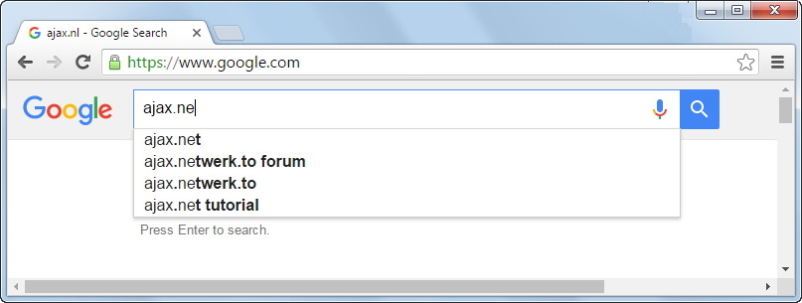
Google’s Auto Suggest feature

Slide 4
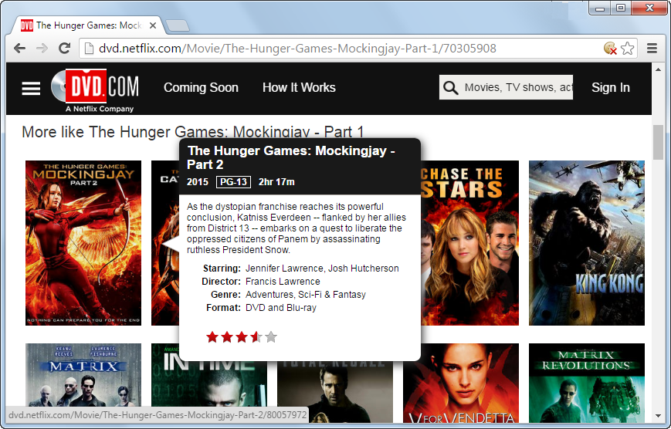
Netflix’s popup feature

Slide 5
How a normal HTTP request is processed

Slide 6
How Ajax updates the contents of a web page

Slide 7
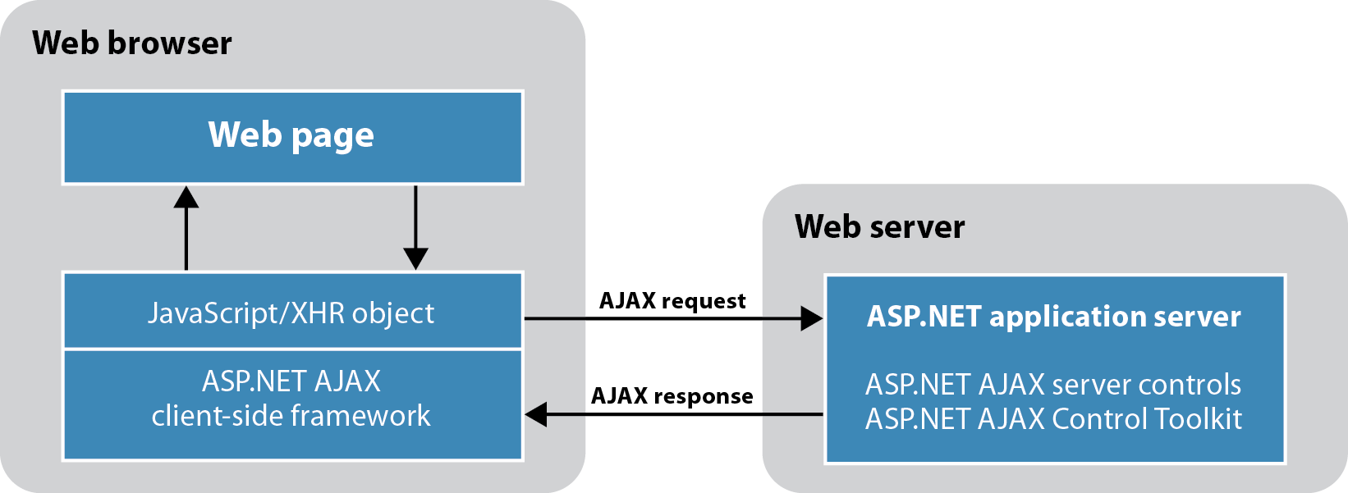
The architecture of ASP.NET Ajax

Slide 8
Components of ASP.NET Ajax

Slide 9
ASP.NET Ajax server controls

Slide 10
The URL for the Ajax Control Toolkit

Slide 11
Common properties of the ScriptManager control

Slide 12
The aspx code for a ScriptManager control

Slide 13
The aspx code for a ScriptManager control that registers two web services

Slide 14
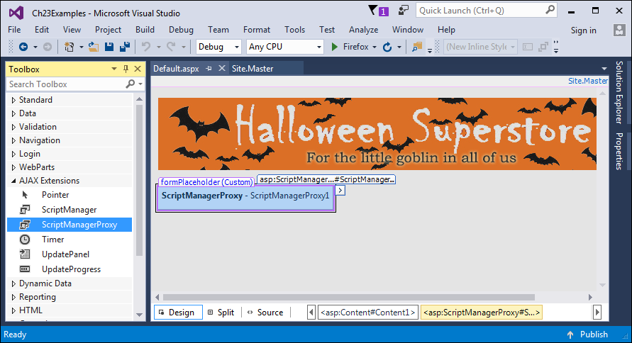
A page with a ScriptManagerProxy control

Slide 15
The aspx for the ScriptManagerProxy control

Slide 16
The aspx code for a ScriptManagerProxy control that registers a service

Slide 17
Two properties of the UpdatePanel control

Slide 18
The starting aspx code for an UpdatePanel control

Slide 19
The aspx code for an UpdatePanel control that specifies triggers

Slide 20
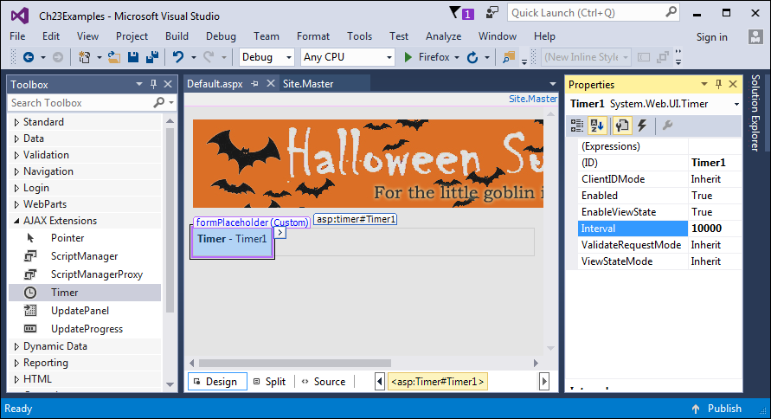
A Timer control in Design view

Slide 21
Two properties of the Timer control

Slide 22
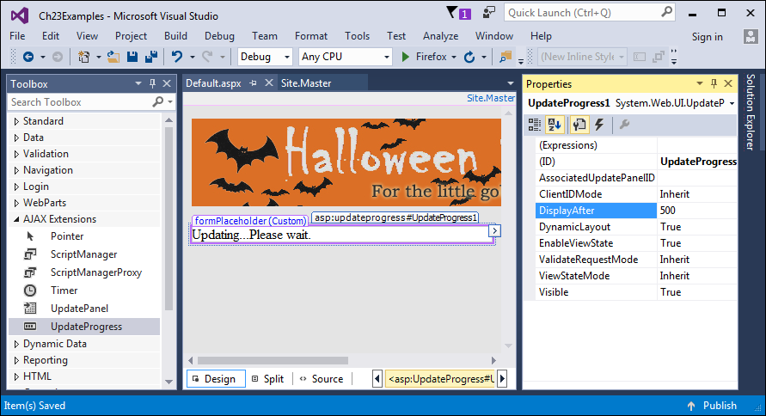
An UpdateProgress control in Design view

Slide 23
Three properties of the UpdateProgress control

Slide 24
The aspx code for an UpdatePanel control with an UpdateProgress control

Slide 25
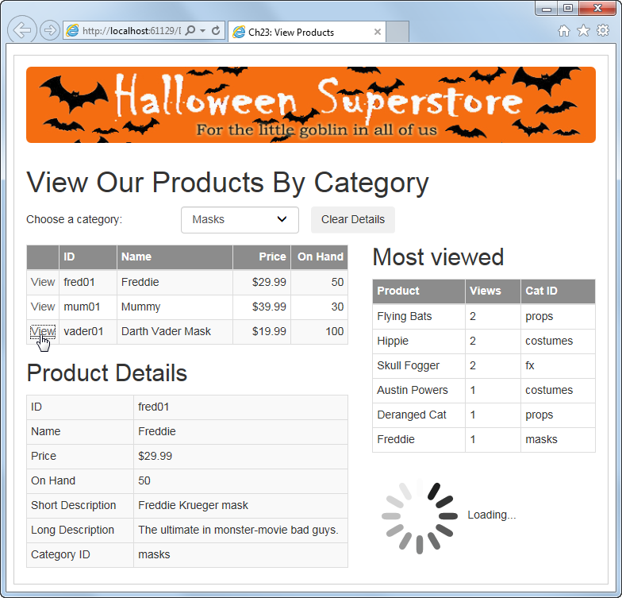
The View Products page

Slide 26
The ProductView.cs file

Slide 27
The ProductViewList.cs file

Slide 28
The ProductViewList.cs file (cont.)

Slide 29
The form element in the Default.aspx file

Slide 30
The form element in the Default.aspx file (cont.)

Slide 31
The form element in the Default.aspx file (cont.)

Slide 32
The form element in the Default.aspx file (cont.)

Slide 33
The form element in the Default.aspx file (cont.)

Slide 34
The form element in the Default.aspx file (cont.)

Slide 35
The form element in the Default.aspx file (cont.)

Slide 36
The Default.aspx.cs file

Slide 37
The Default.aspx.cs file (cont.)

Slide 38
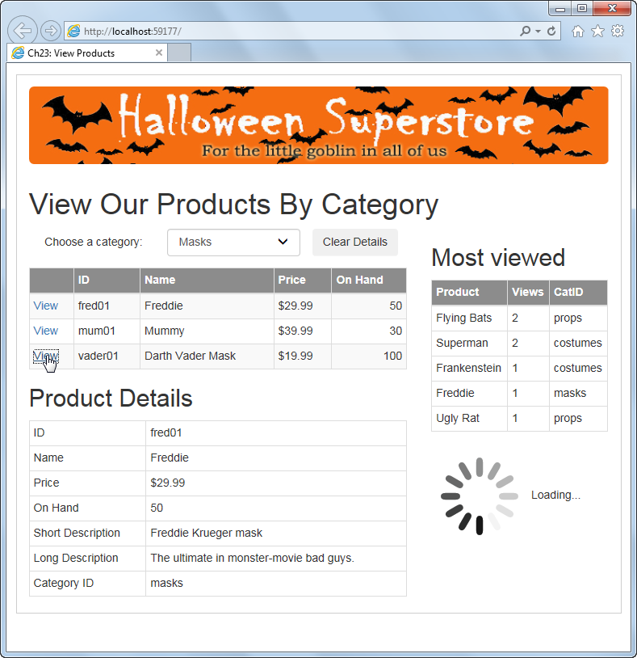
Extra 23-1 Test the View Products application and add an UpdateProgress control

Slide 39
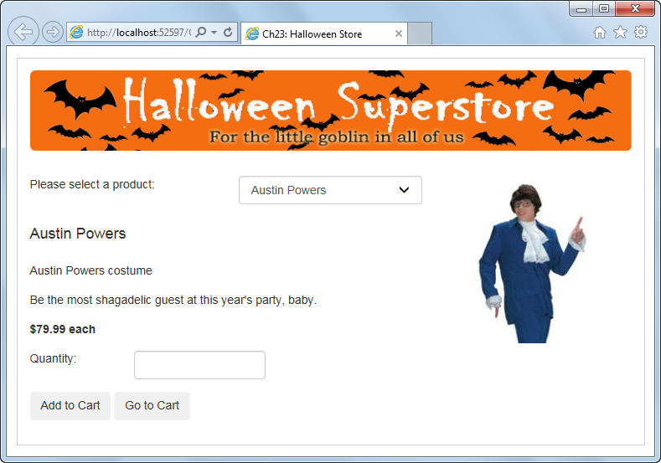
Exercise 23-2 Ajax enable the Halloween Store application

